Slide 1

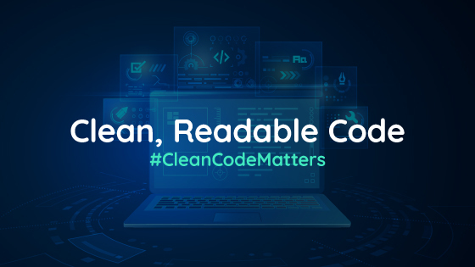

Clean Code 101
Notes:
Welcome to clean code session for beginners ☺

Slide 2

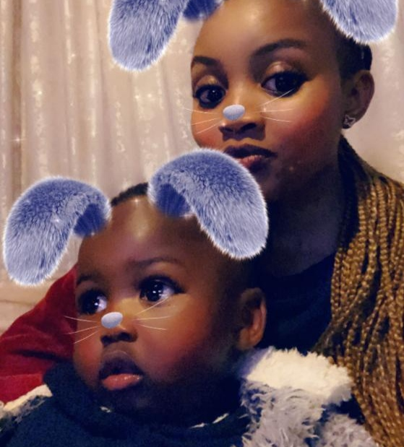


Elinah Mamatlepa
Software Engineer @ Entelect
Notes:
Introduction
Name
Role
Hobbies

Slide 3
Content
What Is Clean Code
Why Clean Code Matters
Who Should Keep Code Clean
How To Keep Code Clean
Summary
Content

Slide 4
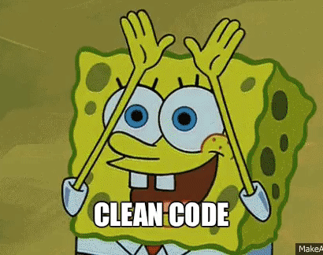
What is Clean Code?
Clean Code is code that is easy to read, easy to understand and easy to change.
Simple, direct and pleasing to read.
Contains no duplication / repetition.
Code that speaks for itself.
Notes:
Notes
- The most popular definition of clean code is that is easy to read, understand and easy to refactor (change)
- Software engineers spend a lot of time interacting with code, investigating bugs and coming up with solutions
- It becomes much easier when the code you are interacting with makes sense and its pleasing to read.
- Code should be as efficient, readable, and maintainable as possible, and instead of only solving the problem, one should always put a bit of extra time in to focus on the design of code.
Code : a set of instructions written in a particular programming language.

Slide 5
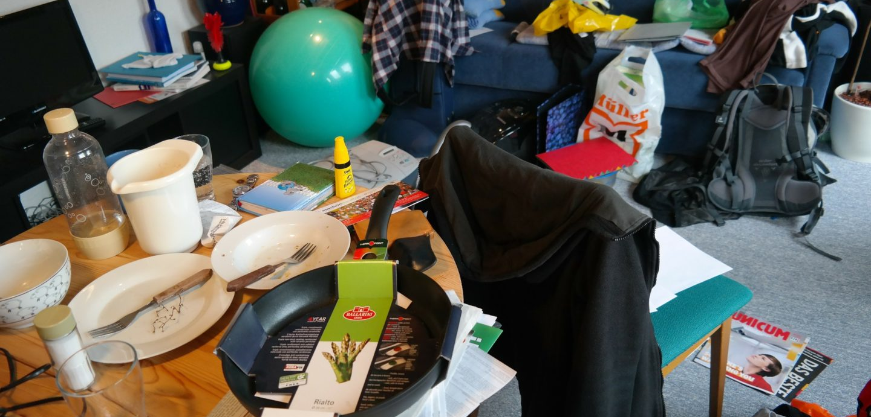
Notes:
Scenario
Let’s say you went out with friends and mistakenly took car keys with you and there is a need to use the car urgently
You need to provide guidance to your sibling / spouse on where to get the spear keys
Will it be easier to direct them with this kind of mess ?
Tell a story of when I had to clean up mess to be able to find something
Have you ever had to deal with any mess and what were you looking for?

Slide 6
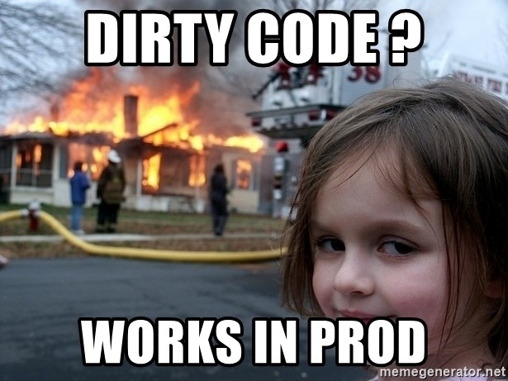
Why Clean Code Matters?
Notes:
Notes:
- Some may argue and say if it works in prod and meets the business objective, what is the use of worrying about cleaning code

Slide 7
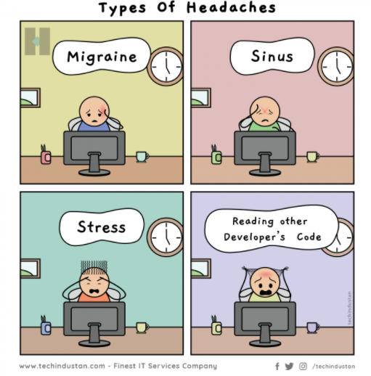
Why Clean Code Matters?
Notes:
Notes:
Clean code matters because trust me you do not want to be the cause of other developer’s headache
As you can see from the picture there are different types of headaches that an individual can get. The guy in fourth picture is even pulling their hair. If you find yourself in a situation where you team member is pulling their hair when looking at your code… Run for your life…Take another look at your code and fix it ☺

Slide 8
Why Clean Code Matters?
Maintenance
Notes:
Notes:
Maintenance is to care for the code and making the code work more efficiently.
Code that is clearly written and self explanatory is easy to maintain
Many developers prefer to rewrite code rather than do the hard work of reading and comprehending existing code that is difficult to understand.
By writing code that is readable, reduces the amount of time that will be spent trying to make sense of the code Which leaves more time to resolving bugs and implementing new features without impacting existing functionality.

Slide 9
Why Clean Code Matters?
Teamwork
Notes:
Notes:
Teamwork : Writing clean code is important because it allows you to clearly communicate with the next person who works with what you've written. Being able to return to previously written code and understand what it does.

Slide 10
Why Clean Code Matters?
Professionalism
Notes:
Notes:
Growth: Writing clean code will allow you to produce quality code you are proud to share with your team.
Also, it makes it almost impossible to say, “Oh no, this code is not mine.” With clean code you won’t need to blame others for the poor quality of the code, clean code is a standard, a foundation for everyone to work on.

Slide 11
Why Clean Code Matters?
Cost-effective
Notes:
Notes:
Clean code clearly communicates what the code does so that it doesn’t slow down the person reading it
Code that doesn’t have a clear direction is time-consuming for everyone involved
Helps reduce the amount of code that is affected by modifications required

Slide 12
Why Clean Code Matters?
Complexity
Notes:
Notes:
The aim of clean code, is not only about readable code but also producing simpler code
Code should be reduced to the lowest level of complexity possible while still providing an adequate solution.
The less thinking that has to be done to make a change the better.

Slide 13
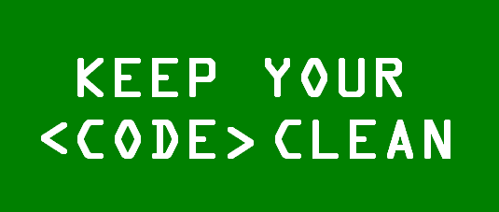
Who needs to keep code clean

Slide 14
Who needs to keep code clean
Everyone involved in the development process
Developers
Code reviewers
Business analysts, etc.
Notes:
Notes:
Everyone
One of the biggest issues within software development industry is that not many people care about clean code
Keeping it clean can be applied everywhere, you do not need to be a software engineer , you can be a business analyst, you can also be a student
Writing clean code is everyone’s job. The developer. PR reviewer. It should be the goal throughout the development process.
- Business Analysts : Clear business requirements
[Ask audience to share more who’s responsible for maintainable solutions, readable requirements or user stories]

Slide 15
How to Keep Code Clean
Notes:
Notes:
We are going to tackle principles one should follow to ensure that code is clean and maintainable in the next slide

Slide 16
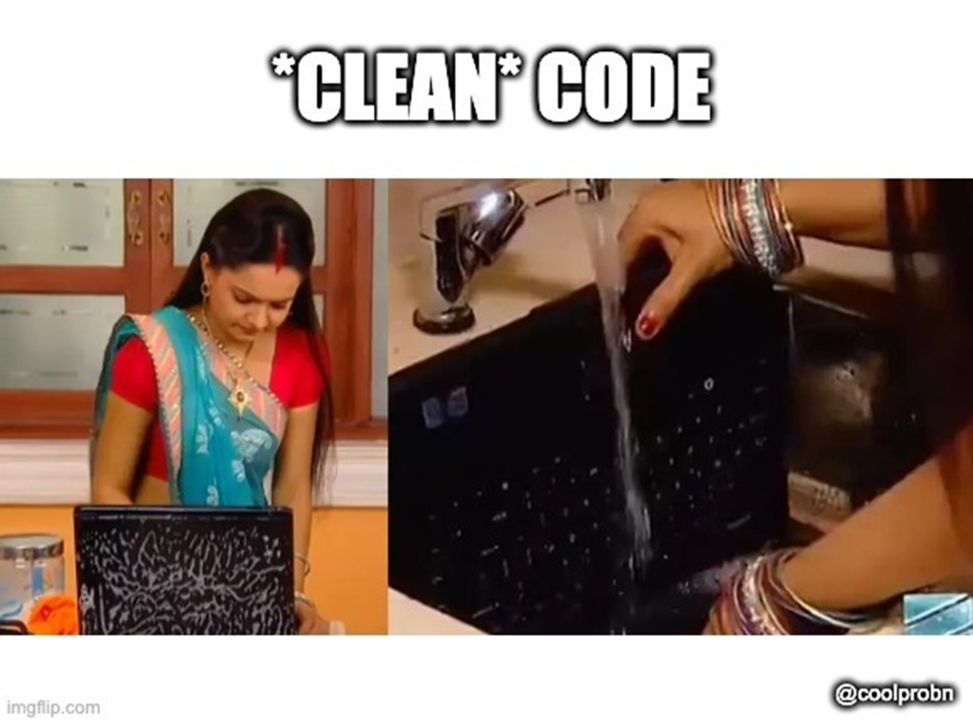
How to Keep Code Clean
Notes:
Notes:
Great, the best way to clean code is to wash it. Take your laptop and have the code open on running tab. It will come back cleaner. Works even better if you add little bit of washing powder ☺
(Just joking this is not right way of cleaning code)

Slide 17
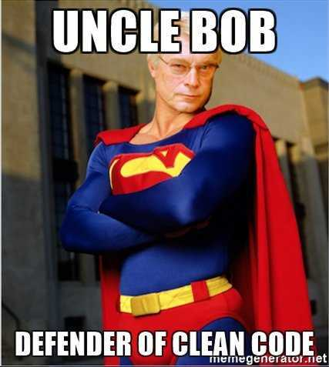
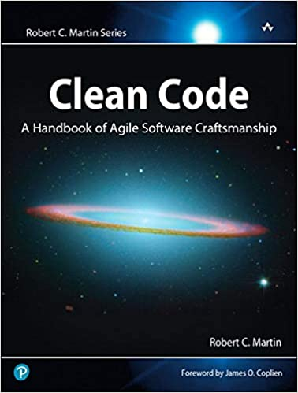
How to Keep Code Clean
Notes:
Notes:
We will discuss the principles and rules that most developers follow and refer to which is Uncle Bob’s Clean code
We will dive more into the rules on the coming slides, and they are all referenced from the book shown on the slide.

Slide 18
How to Keep Code Clean
Code Smells
Rigidity. The software is difficult to change. A small change causes a cascade of subsequent changes.
Fragility. The software breaks in many places due to a single change.
Immobility. You cannot reuse parts of the code in other projects because of involved risks and high effort.
Needless Complexity.
Needless Repetition.
Opacity. The code is hard to understand.
Notes:
Notes:
Before we dive into the hows, I would like for us to first understand what we mean by code smells.
I used to hear that code smells and wondered what it meant. I now have an idea of what it means
Code smells are not bugs or errors. but violations of the fundamentals of developing software that decrease the quality of code.
“Smelly" code could be inefficient, nonperforming, complex, and difficult to change and maintain and leads to discoveries of decreased code quality

Slide 19
How to Keep Code Clean
General Rules
Follow standard conventions
Keep it simple stupid.
Always find the root cause of a problem
Boy Scout Rule - Leave the code cleaner than you found it.
Notes:
Notes:
Follow coding design standard conventions.
Keep it simpler, reduce complexity as much as possible.
Boy scout rule. Leave the campground cleaner than you found it.
Stay in the problem space, always look for the root cause of the problem

Slide 20
How to Keep Code Clean
Design Rules
Keep configurable data at high levels.
Prefer polymorphism to if/else or switch/case.
Be precise
Use dependency injection.
Follow Law of Demeter. A class should know only its direct dependencies.
Notes:
Notes:
Keep configurable data at high levels
If you have a constant such as default or configuration value that is known and expected at a high level of abstraction, do not bury it in a low-level function. Expose it as an argument to the low-level function called from the high-level function.
Prefer polymorphism to if/else or switch/case.
- Polymorphism describes situations in which something occurs in several different forms. It describes a concept that you can access objects of different types through the same interface. Each type can provide its own independent implementation of this interface.
Be precise
- When you make a decision in your code, make sure you make it precisely. Know why you have made it and how you will deal with any exceptions.
Use dependency injection
Dependency means relying on something
dependency injection is a technique whereby one object (or static method) supplies the dependencies of another object
When class A uses some functionality of class B, then it’s said that class A has a dependency of class B.
Follow Law of Demeter.
- A class should know only its direct dependencies.

Slide 21
Scenario : Prefer polymorphism to if/else or switch/case
We have a system that keeps record of user details.
New requirement:
Users should be able to change their details e.g. email address, physical address, marital status
The changes should be saved in the database
Notes:
Notes:

Slide 22
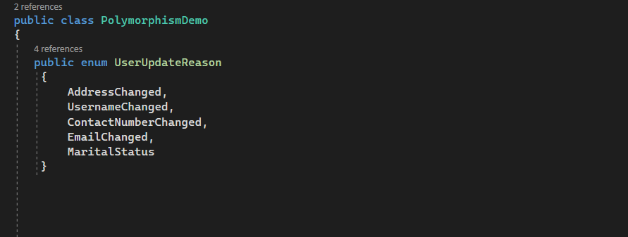
Scenario : Prefer polymorphism to if/else or switch/case.
Notes:
Notes

Slide 23
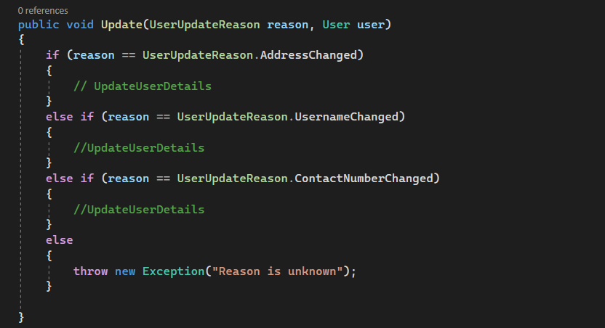
Scenario : Prefer polymorphism to if/else or switch/case.
Notes:
Notes
With this approach, we continuously have to add additional branches and whenever you have to debug have to go through a bunch of if statements before accessing the one you are interested in investigating.
Lets look at a dummy example of how we avoid traditional branching with polymorphism

Slide 24
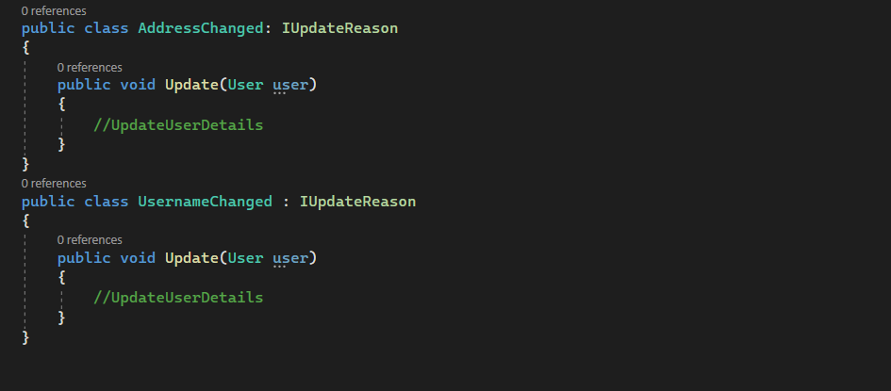
Prefer polymorphism to if/else or switch/case.
Notes:
Notes
Every class is aligned with the requirement it manages. Debugging, fixing bugs, and testing is easier than compared to the conditional branching
There is a clear relationship between the class and the requirement it manages.
In this case, any new requirement results in a specialized class
We are now taking an interface argument instead of the enum. Now, the method delegates the responsibility of knowing how to perform the update to a specialized object

Slide 25
How to Keep Code Clean
Understandability Tips
Be consistent. If you do something a certain way, do all similar things in the same way.
Use explanatory variables.
Avoid logical dependency. Don't write methods which works correctly depending on something else in the same class.
Avoid negative conditionals.
Encapsulate boundary conditions. Boundary conditions are hard to keep track of. Put the processing for them in one place.
Notes:
Notes:
Consistency
Use explanatory variables.
Avoid logical dependency. Don't write methods which works correctly depending on something else in the same class.
Avoid negative conditionals.
Encapsulate boundary conditions. (explained better in next slide)

Slide 26
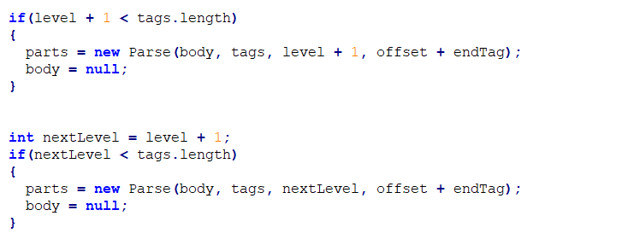
How to Keep Code Clean
Understandability Tips: Encapsulate boundary conditions
Notes:
Notes
- Notice that level + 1 appears twice. This is a boundary condition that should be encapsulated within a variable named something like nextLevel.

Slide 27
How to Keep Code Clean
Naming Rules
Choose descriptive and unambiguous names.
Make meaningful distinction.
Use pronounceable names.
Use searchable names.
Replace magic numbers with named constants.
Avoid encodings. Don't append prefixes or type information.
Notes:
Notes:
Choose descriptive and unambiguous names.
Make meaningful distinction.
Use pronounceable names.
Use searchable names.
Replace magic numbers with named constants.
Avoid encodings. Don't append prefixes or type information.

Slide 28
Naming Rules Scenario
We have a data payment system that users use to purchase their day to day or monthly data bundles.
Requirement: Users would like to have the ability to view all Data bundles they have purchased for a specific month .
What is the name of the function that will be used to extract information related to Data bundles That the user purchased?
Notes:
Notes:
Function:
- We have a data payment system that users use to purchase their day to day or monthly data bundles.
Requirement:
- Users would like to have the ability to view all Data bundles they have purchased for a specific month .
Question
- What is the name of the function that will be used to extract information related to Data bundles That the user purchased?

Slide 29
Naming Rules Scenario
GetMonthlyDataBundleTransactions()
FetchMonthlyTransactions()
Notes:
Notes:

Slide 30
How to Keep Code Clean
Function Rules
Functions should be small
Do one thing.
Use descriptive names.
Prefer fewer arguments.
Don't use flag arguments. Split method into several independent methods that can be called from the client without the flag.
Notes:
Notes:
Small - functions should be small and obey the Single Responsibility Principle (SRP) - Functions should not be more than 4 lines.
They should also do one and only one thing
Use descriptive names.
Prefer fewer arguments.
Don't use flag arguments. Split method into several independent methods that can be called from the client without the flag.
- A flag argument is a kind of function argument that tells the function to carry out a different operation depending on its value

Slide 31
How to Keep Code Clean
Comments Rules
Always try to explain yourself in code.
Don't be redundant.
Don't add obvious noise.
Don't use closing brace comments.
Don't comment out code. Just remove.
Use as explanation of intent.
Use as clarification of code.
Use as warning of consequences.
Notes:
Notes:
Always try to explain yourself in code.
Don't be redundant.
Don't add obvious noise.
Don't use closing brace comments.
Don't comment out code. Just remove.
Use as explanation of intent.
Use as clarification of code.
Use as warning of consequences.

Slide 32
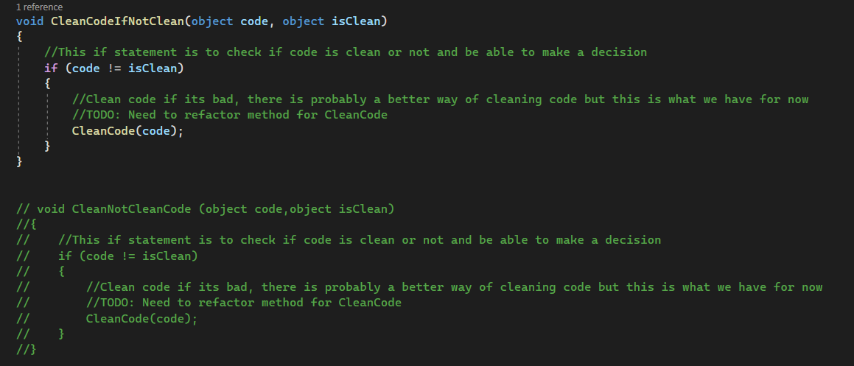
Comments Rules
Notes:
Notes:
Let’s take a look at the given example of code with comments
Let’s go through it together line by line
Discussion on if this code is clean

Slide 33
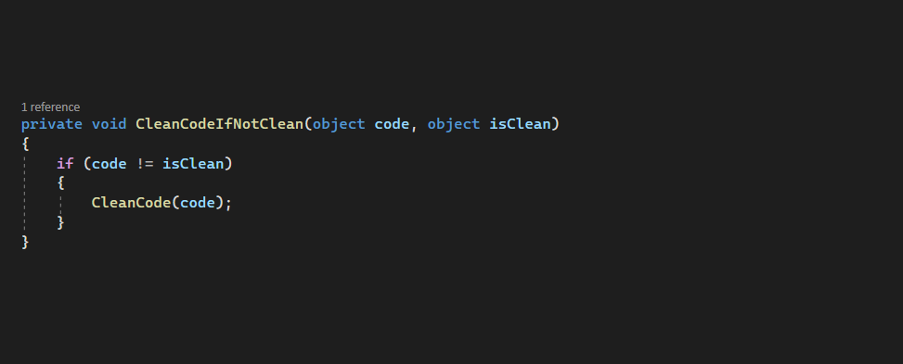
Comments Rules
Notes:
Notes:
How is it different from previous code with code

Slide 34
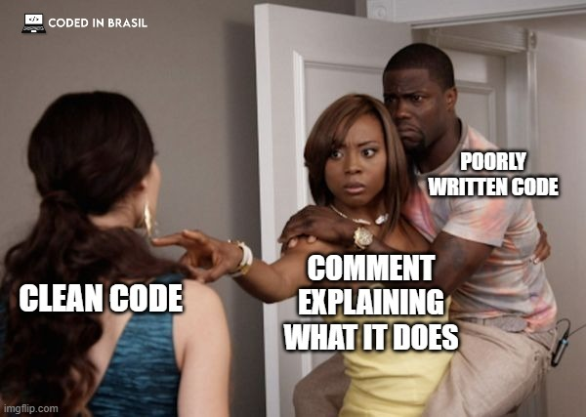
How to Keep Code Clean
Comments Rules
Notes:
Notes
There is a saying that says “Don’t comment bad code, rewrite it”
Question: When is it necessary to add comments ?

Slide 35
How to Keep Code Clean
Source Code Structure
Separate concepts vertically.
Related code should appear vertically dense.
Declare variables close to their usage.
Dependent functions should be close.
Similar functions should be close.
Place functions in the downward direction.
Keep lines short.
Don't use horizontal alignment.
Use white space to associate related things and disassociate weakly related.
Don't break indentation.
Notes:
Notes:
Separate concepts vertically.
Related code should appear vertically dense.
Declare variables close to their usage.
Dependent functions should be close.
Similar functions should be close.
Place functions in the downward direction.
Keep lines short.
Don't use horizontal alignment.
Use white space to associate related things and disassociate weakly related.
Don't break indentation.

Slide 36
How to Keep Code Clean
Code Formatting Tools
ESLint
POOR SLQ
EditorConfig
Notes:
Notes:
- Numerous tools exists to automatically format code where it follows a specific style
EditorConfig – a language independent tool that helps maintain consistent whitespace styles
ESLint is a linting tool for Javascript shows you problems form a certain set of rules in your code without executing the code
Poor sql – open source sql formatter
* Ask audience to share more

Slide 37
How to Keep Code Clean
Objects and data structures
Hide internal structure.
Prefer data structures.
Should be small.
Do one thing.
Small number of instance variables.
Base class should know nothing about their derivatives.
Better to have many functions than to pass some code into a function to select a behavior.
Prefer non-static methods to static methods.
Notes:
Notes
Hide internal structure.
Prefer data structures.
Should be small.
Do one thing.
Small number of instance variables.
Base class should know nothing about their derivatives.
Better to have many functions than to pass some code into a function to select a behavior.
Prefer non-static methods to static methods.

Slide 38
How to Keep Code Clean
Tests
One assert per test.
Readable.
Fast.
Independent.
Repeatable.
Notes:
Notes
There will be a presentation later in the year regarding testing which will go more in-depth
One assert per test.
Readable.
Fast.
Independent.
Repeatable.

Slide 39
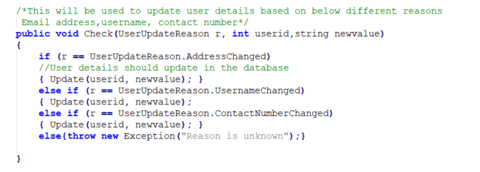
Exercise
What is wrong with code below?
Notes:
- Can breakout into rooms to discuss this among groups or just discuss it in the session
Let’s take scenario of updating user details.
Go through the code and list things that are wrong with that piece of code
How would you make it better if you had to change it

Slide 40
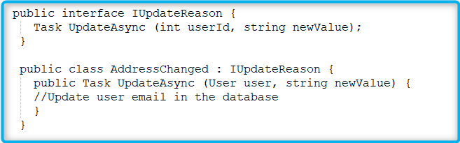
Answers
Unnecessary comments
Use of traditional branching ( if statements)
Wrong naming of the variables
Not self explanatory
No indentation
Missing curly brace on one of the if statements
Notes:
Unnecessary comments
Use of traditional branching ( if statements)
Wrong naming of the variables
Not self explanatory
No indentation
Missing curly brace on one of the if statements ( on UsernameChanged)
Replace traditional branching with polymorphic approach and there is a relationship between the class and the requirement it manages
The method delegate responsibility of knowing how to perform the update

Slide 41
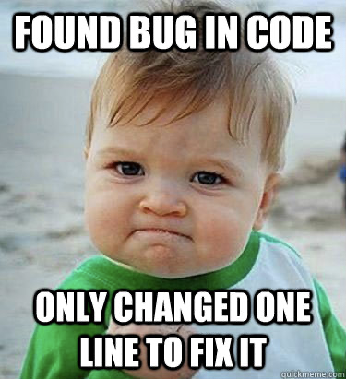
Notes:
Notes:
Great now we are ready to go start writing clean readable code☺

Slide 42
Summary
KISS - Keep It Simple and Stupid.
DRY - Don’t Repeat Yourself.
Don't break indentation
Boy Scout Rule - Leave the code cleaner than you found it.
Be consistent. If you do something a certain way, do all similar things in the same way

Slide 43
Summary
Always find the root cause of the problem
Choose descriptive names
Don’t add obvious noise
Don’t comment out code, remove it
Follow Law of Demeter. A class should know only its direct dependencies.

Slide 44


Slide 45


